Slide 1



Student exchange program to China

Slide 2

INTRODUCTION
Program Title: Student Exchange Program to China
Dates: 9–12 September 2025
Location: Chengdu, Mianzhu, Guanghan – Sichuan Province, China
Delegation: 12 students from 11 schools, 1 official from Ministry of Education

Slide 3
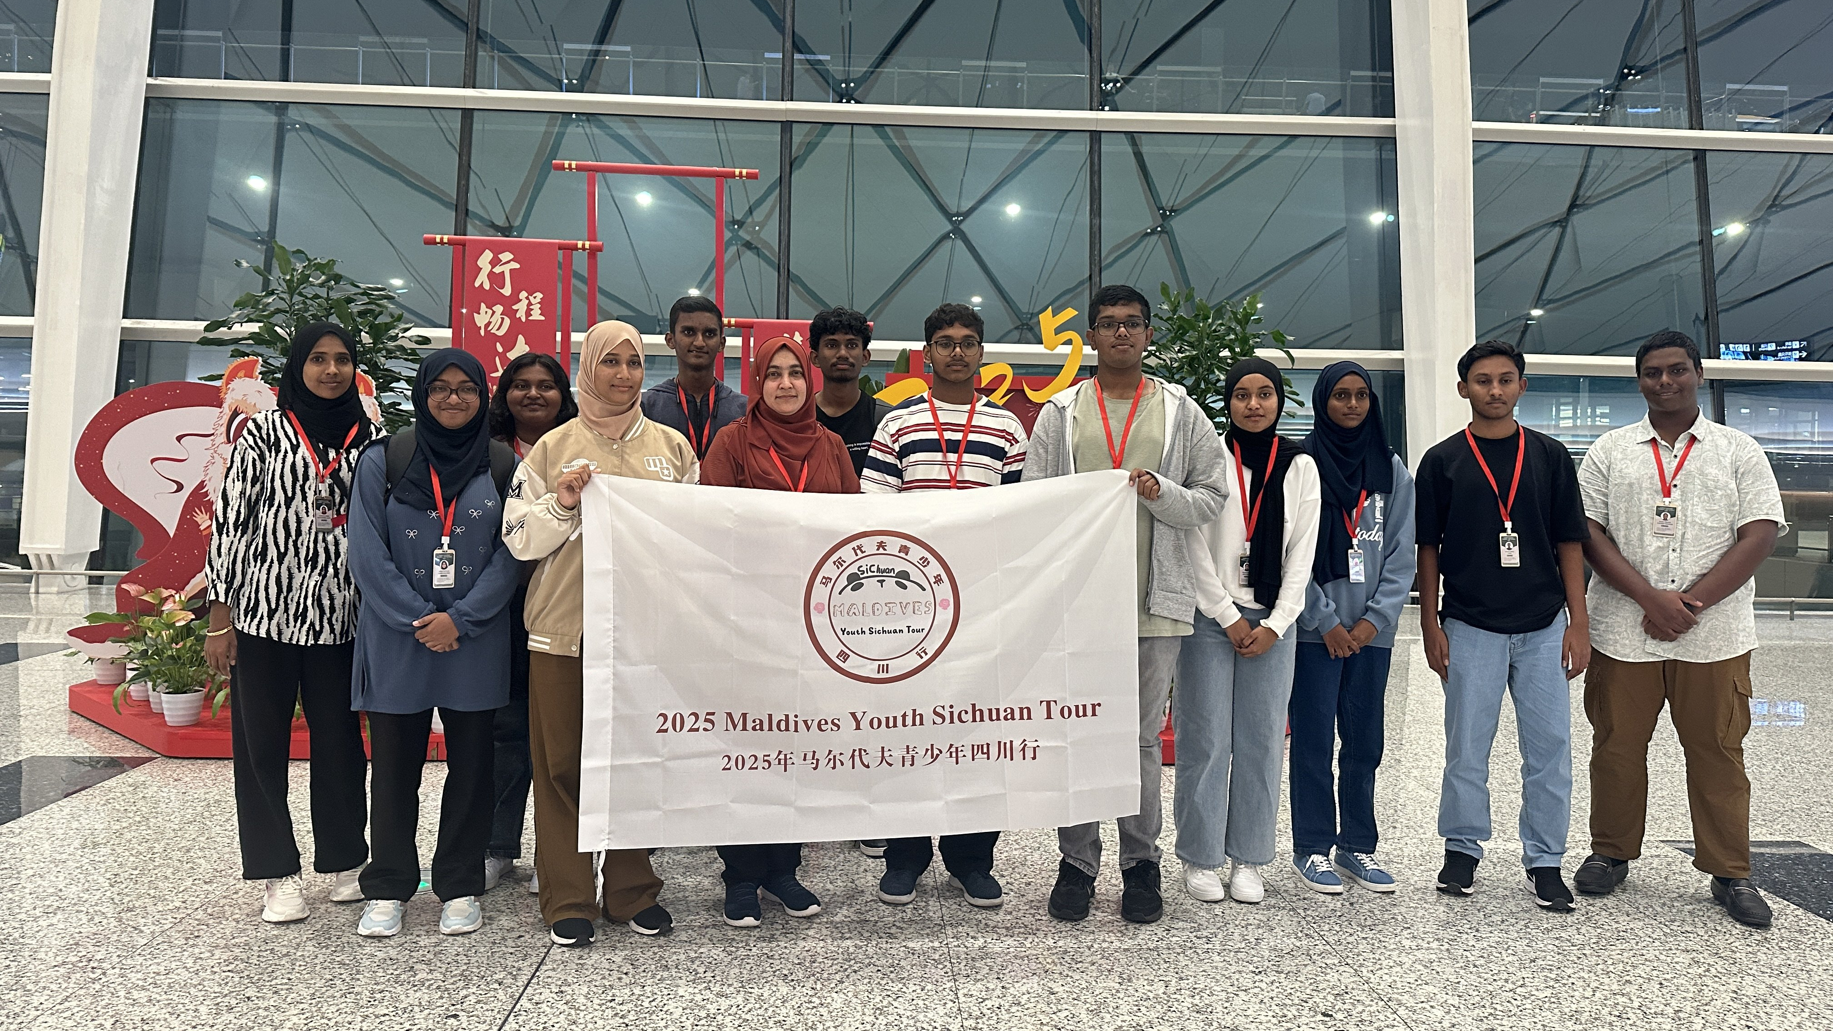
ARRIVAL

Slide 4
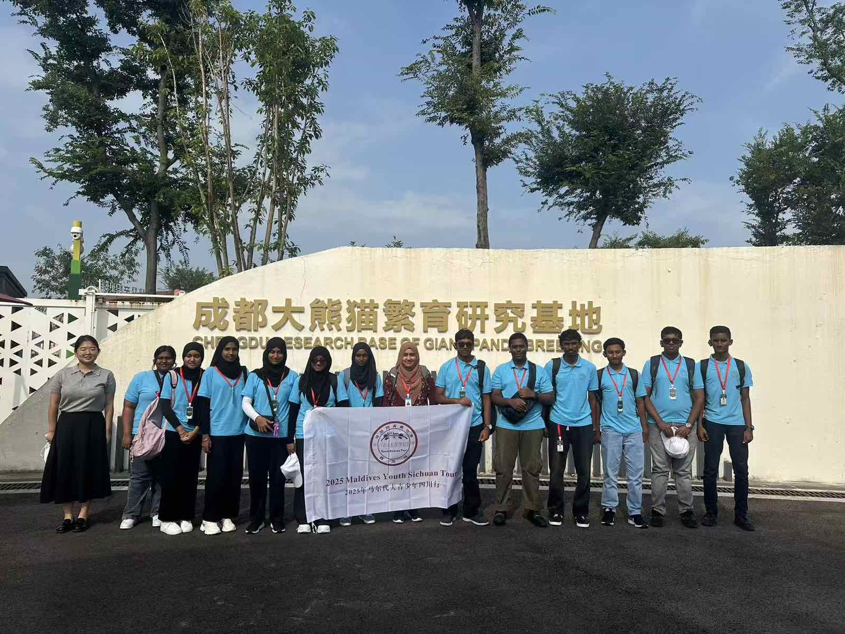
VISITING CHENGDU RESEARCH BASE OF GIANT PANDA BREEDING
INTRO

Slide 5
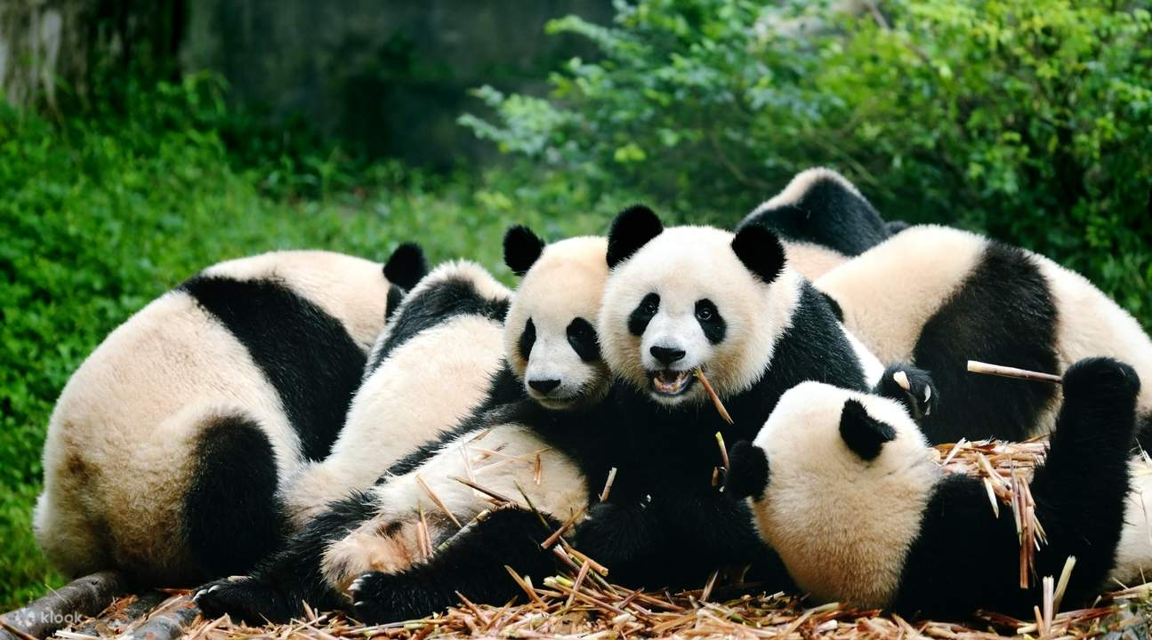
GIANT PANDA
ABOUT

Slide 6
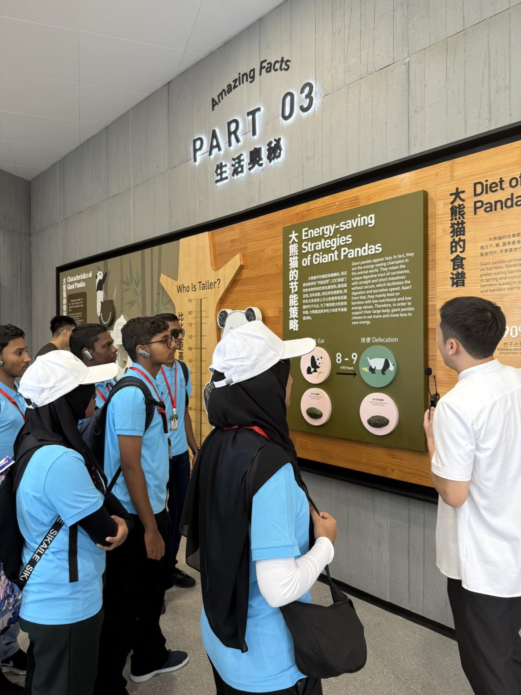
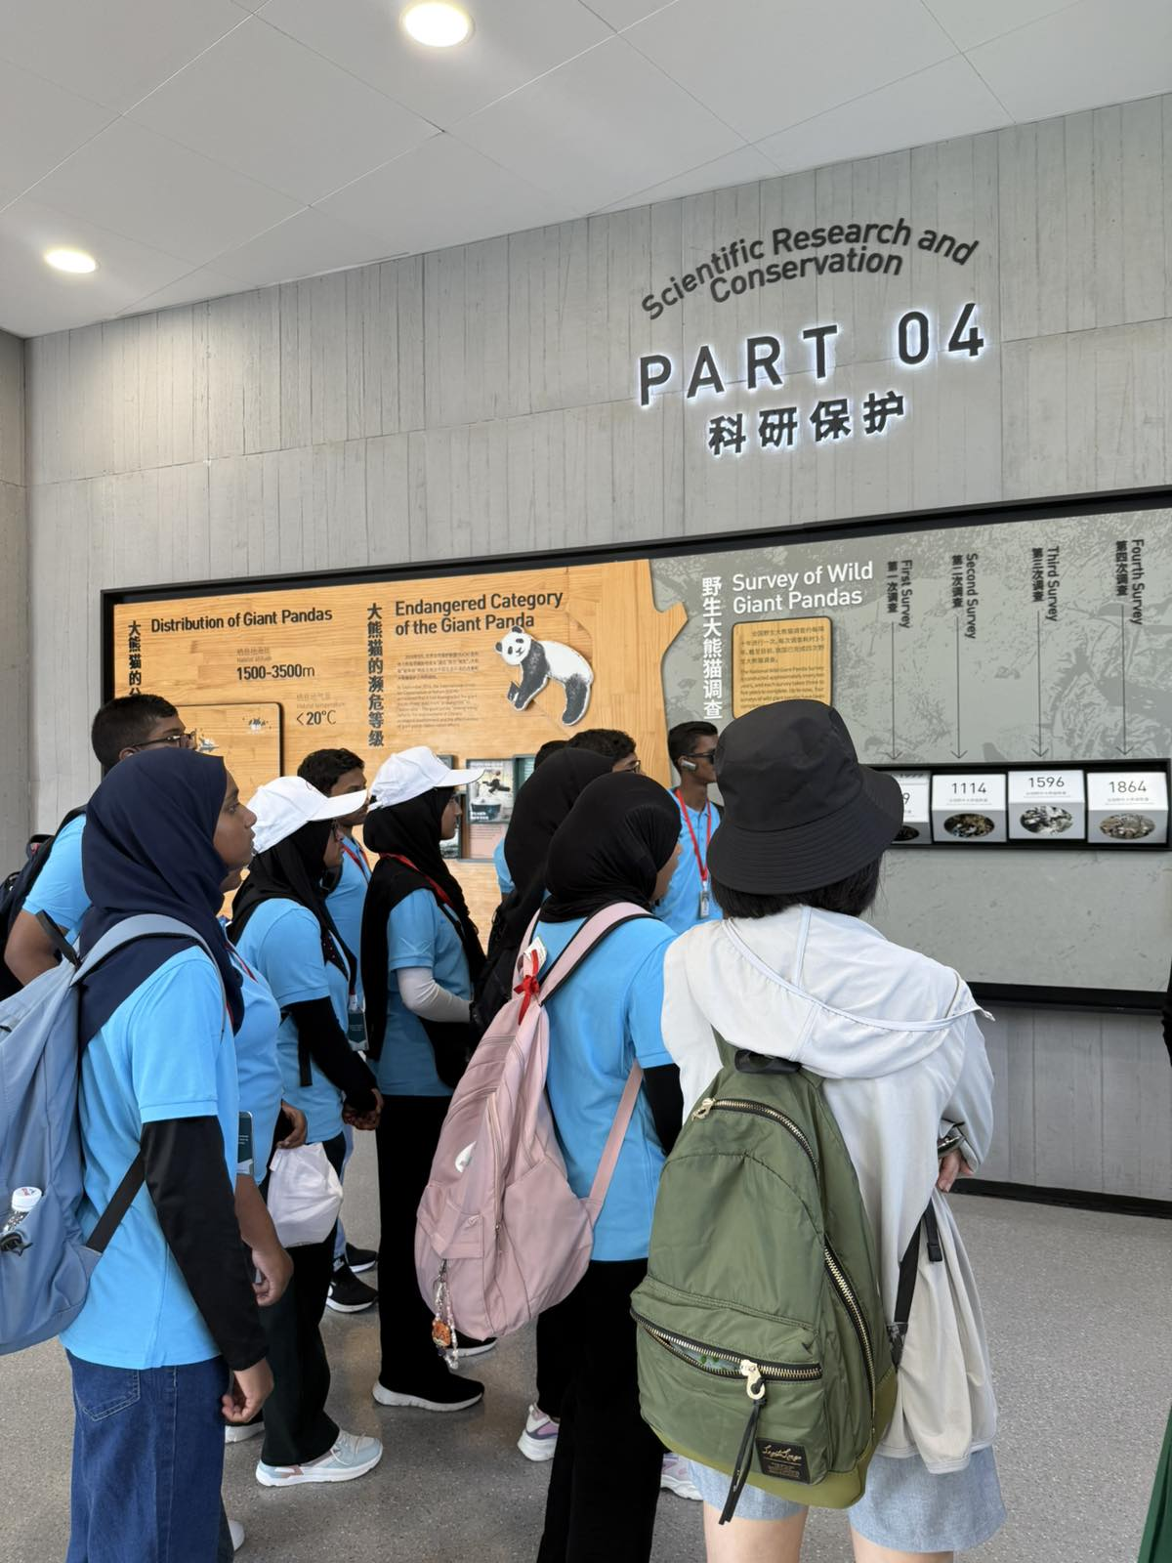
LEARNT

Slide 7
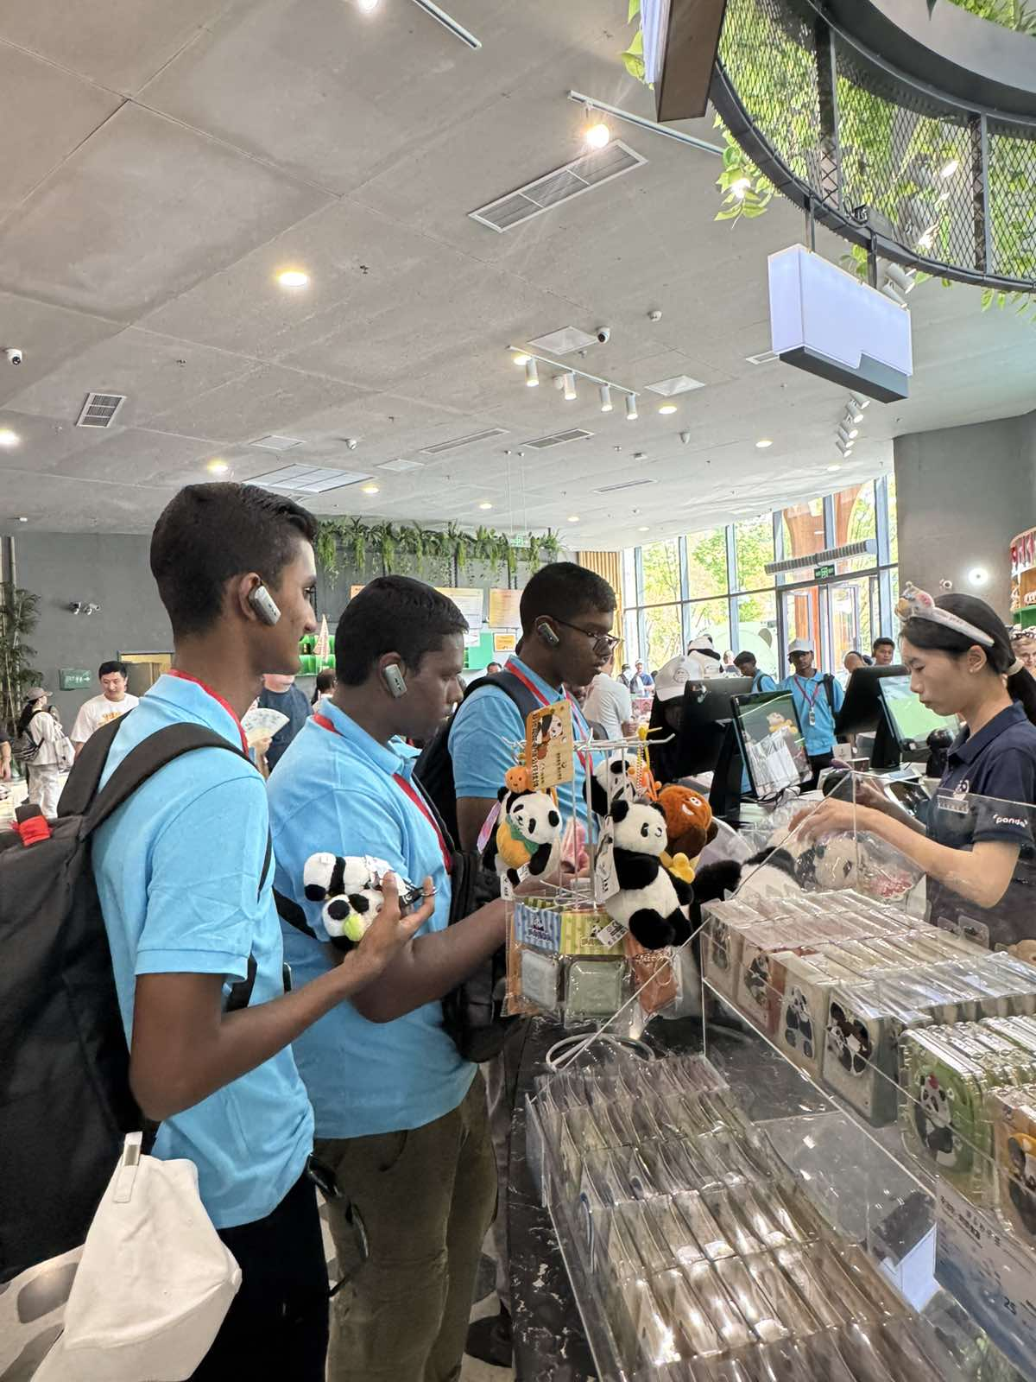
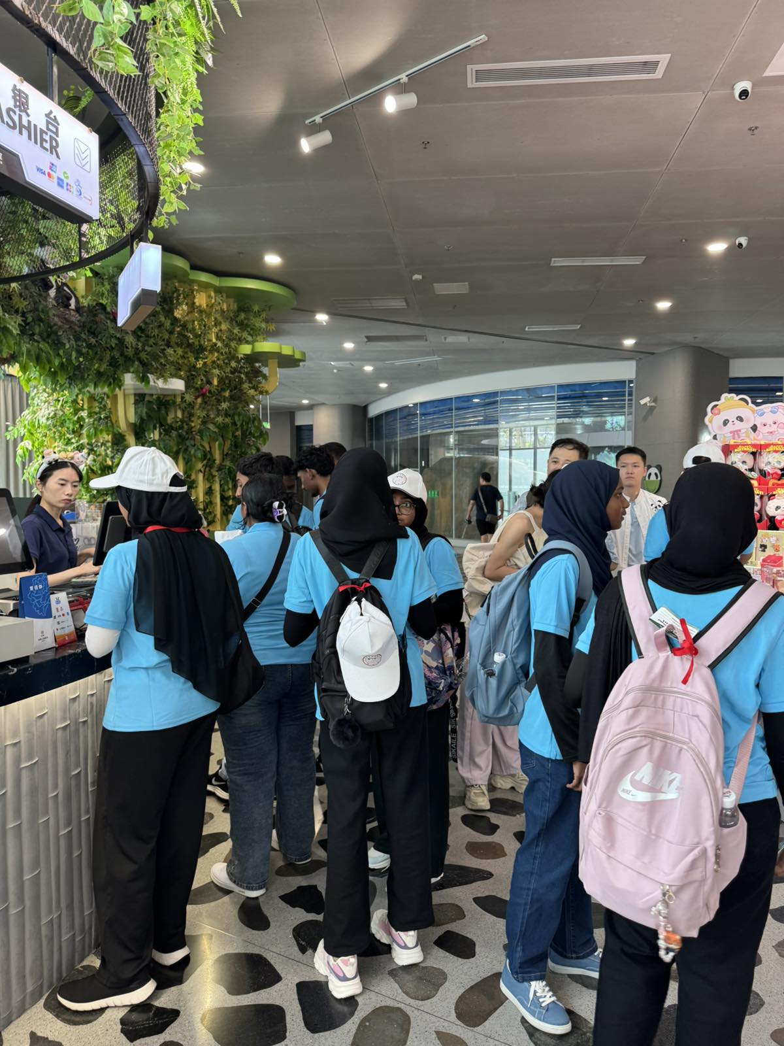
CONCLUSION

Slide 8

Martial Arts
Learnt
Shrine Museum
Jinli Street
VISITING MARTIAL ARTS BASE

Slide 9
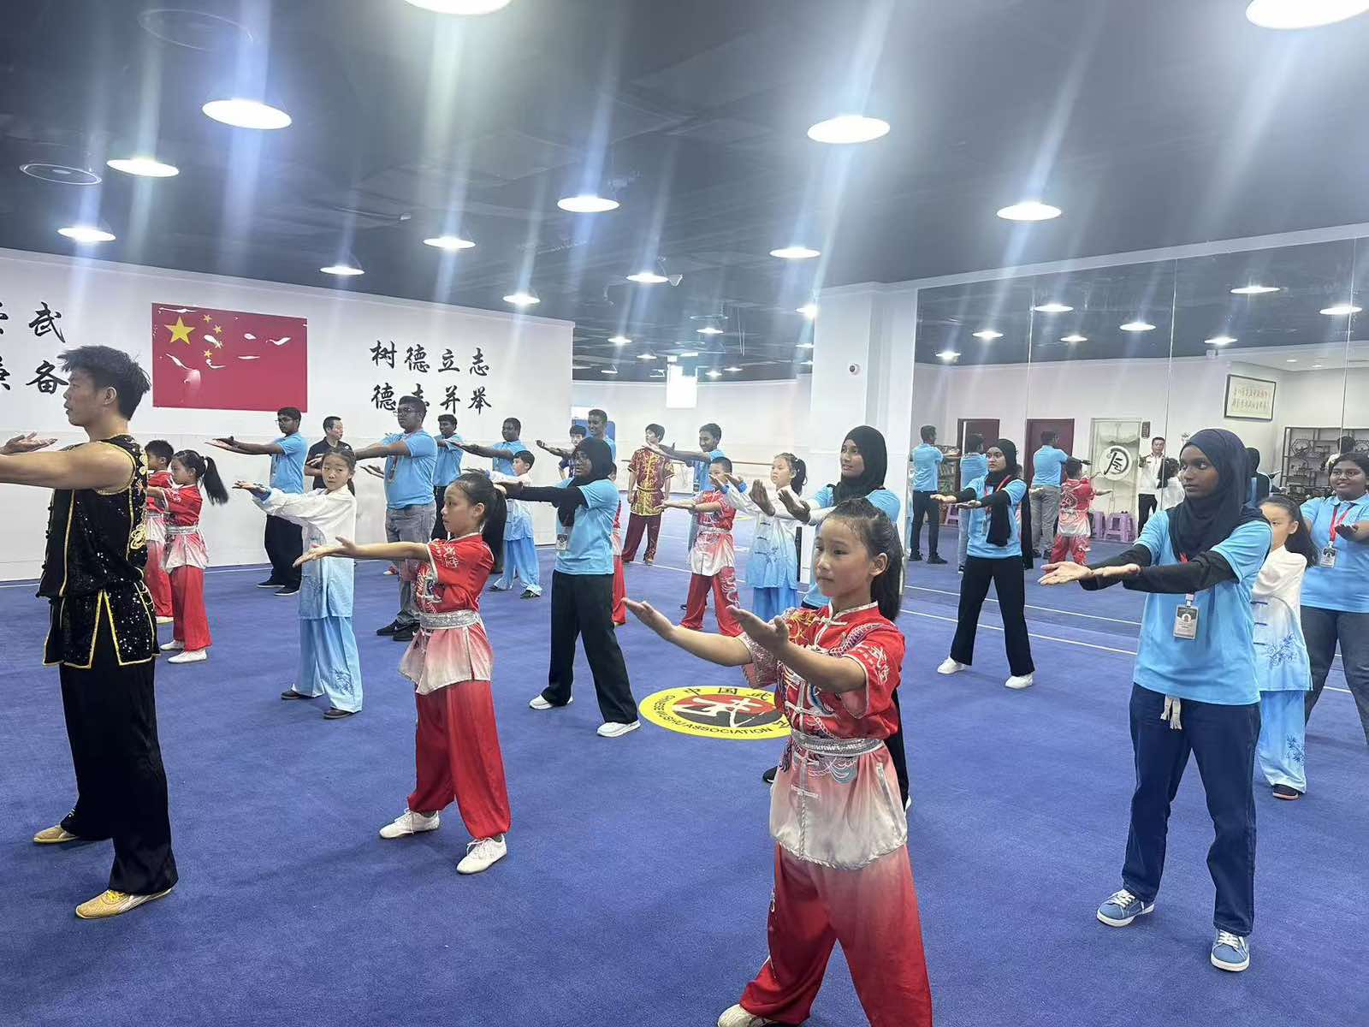
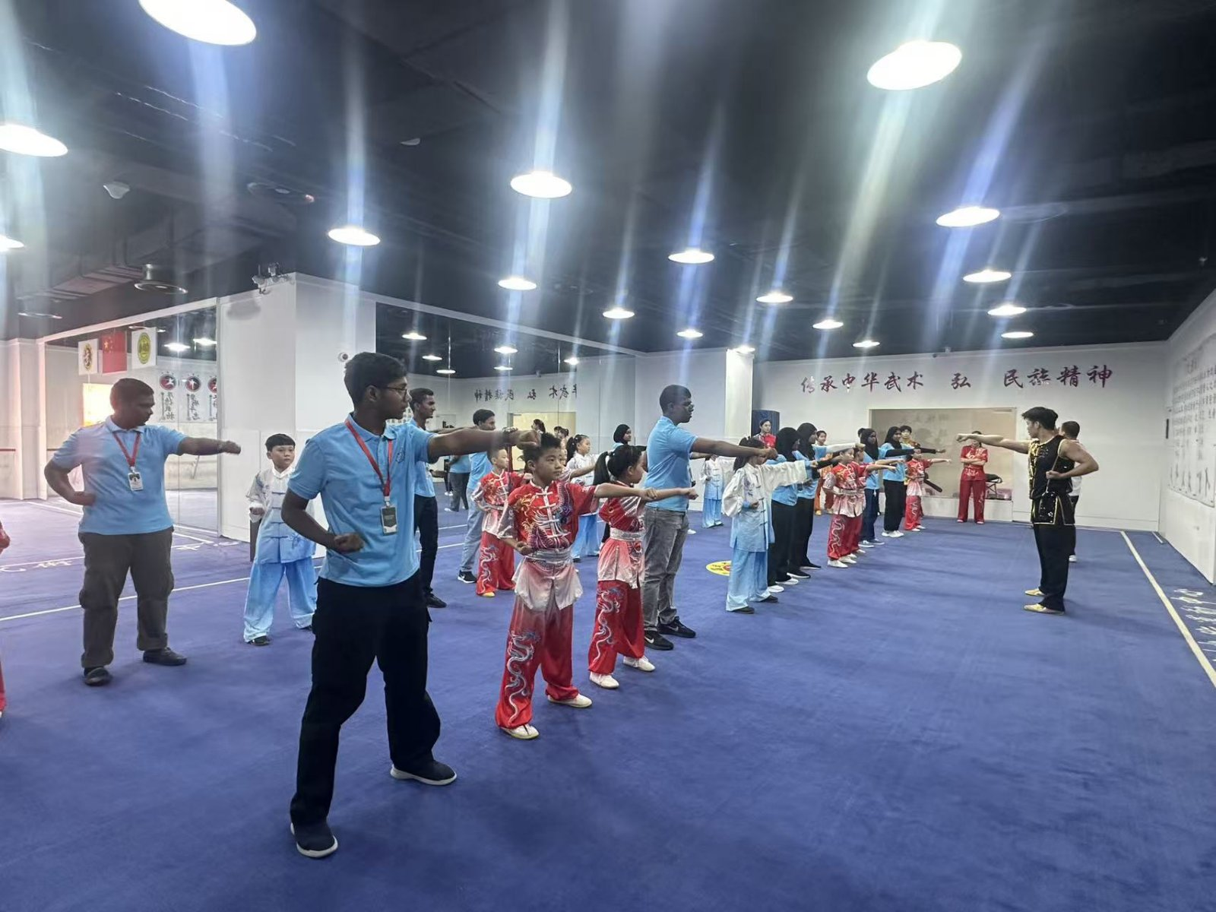
Kung Fu
Learnt
Shrine Museum
Jinli Street
EXPERIENCING
CHINESE MARTIAL ARTS

Slide 10
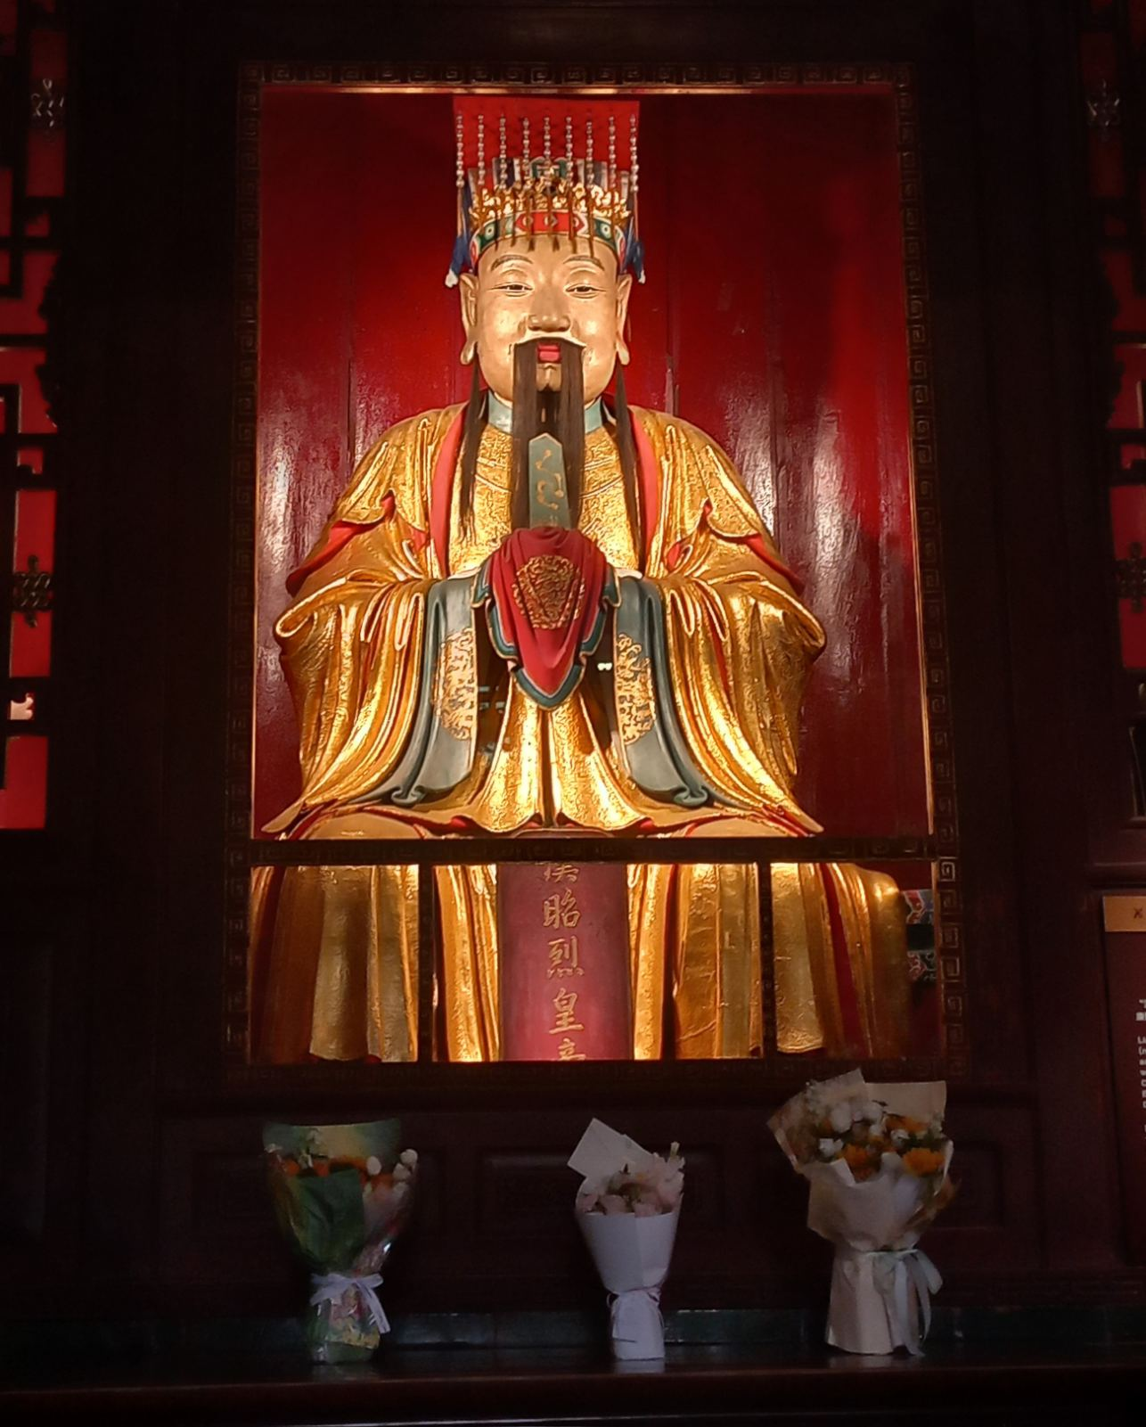
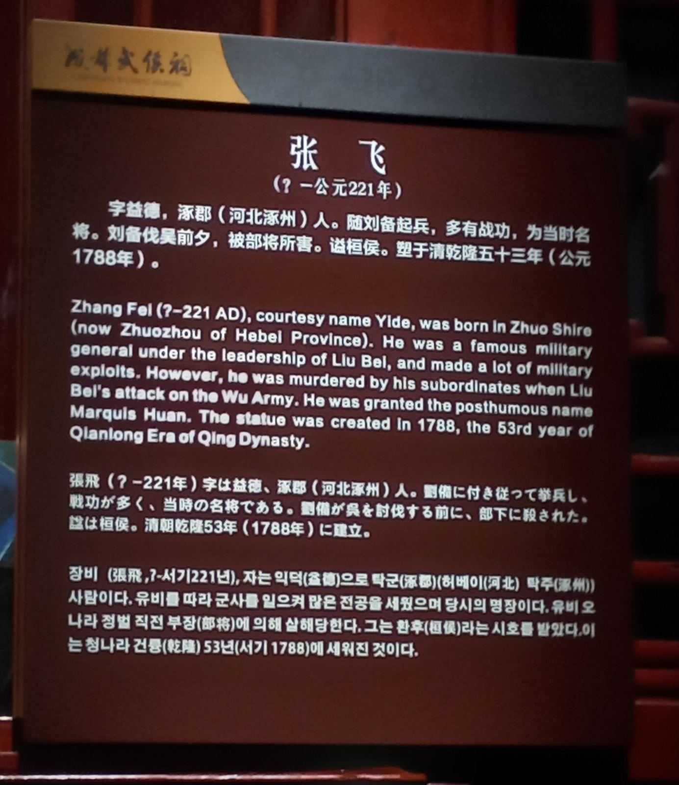
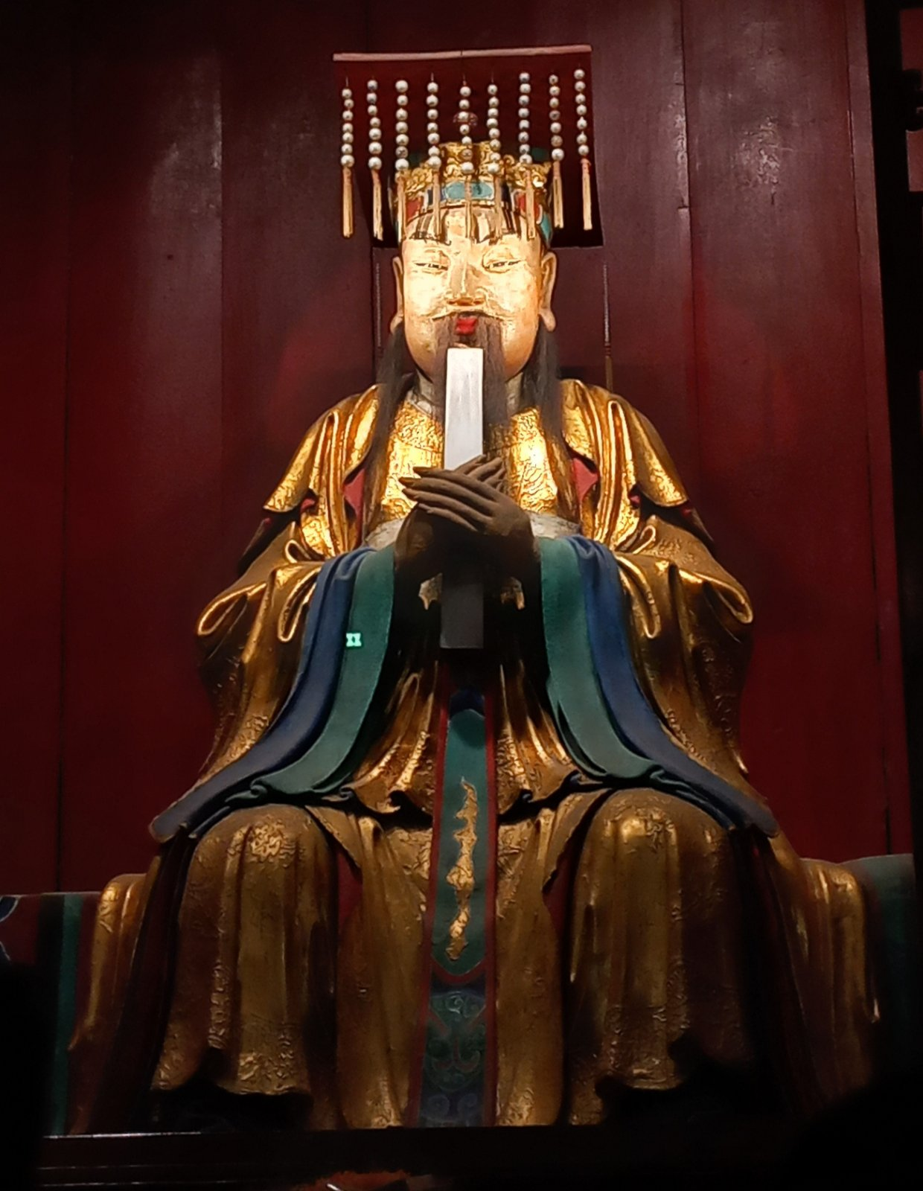
Kung Fu
Learnt
Shrine Museum
Jinli Street
VISITING WUHOU SHRINE MUSEUM

Slide 11

Kung Fu
Learnt
Shrine Museum
Jinli Street
VISITING
JINLI ANCIENT STREET

Slide 12

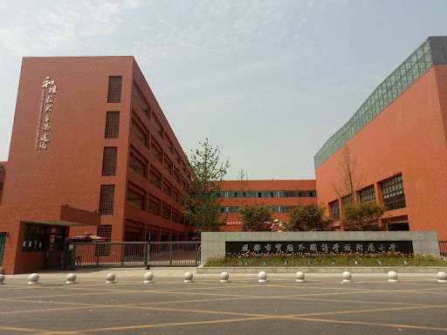



VISITING CHENGHUA PRIMARY SCHOOL

Slide 13
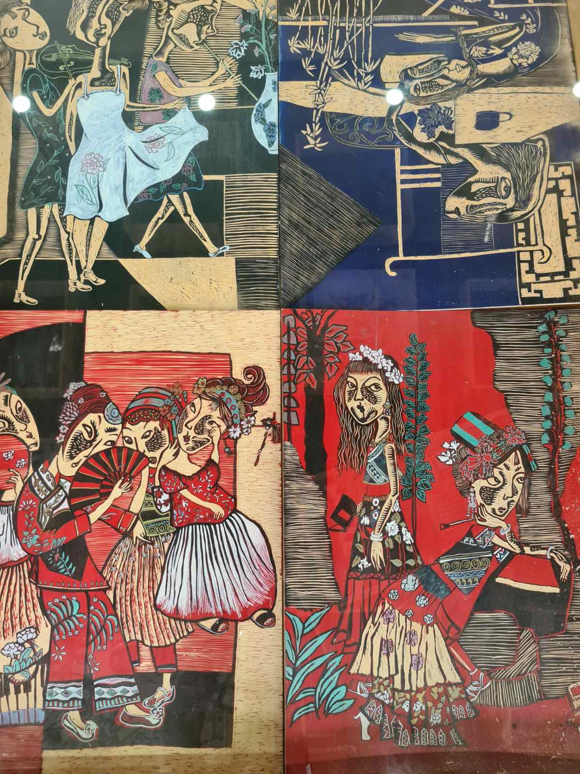
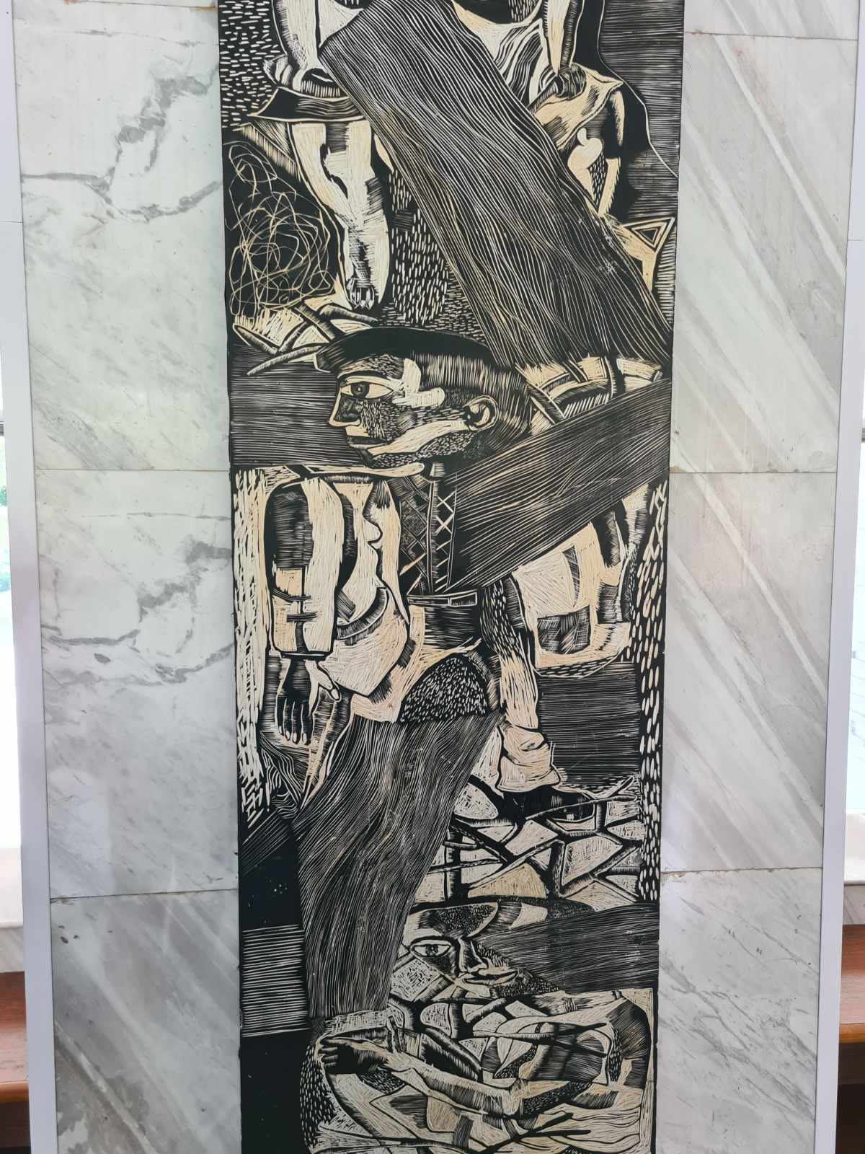
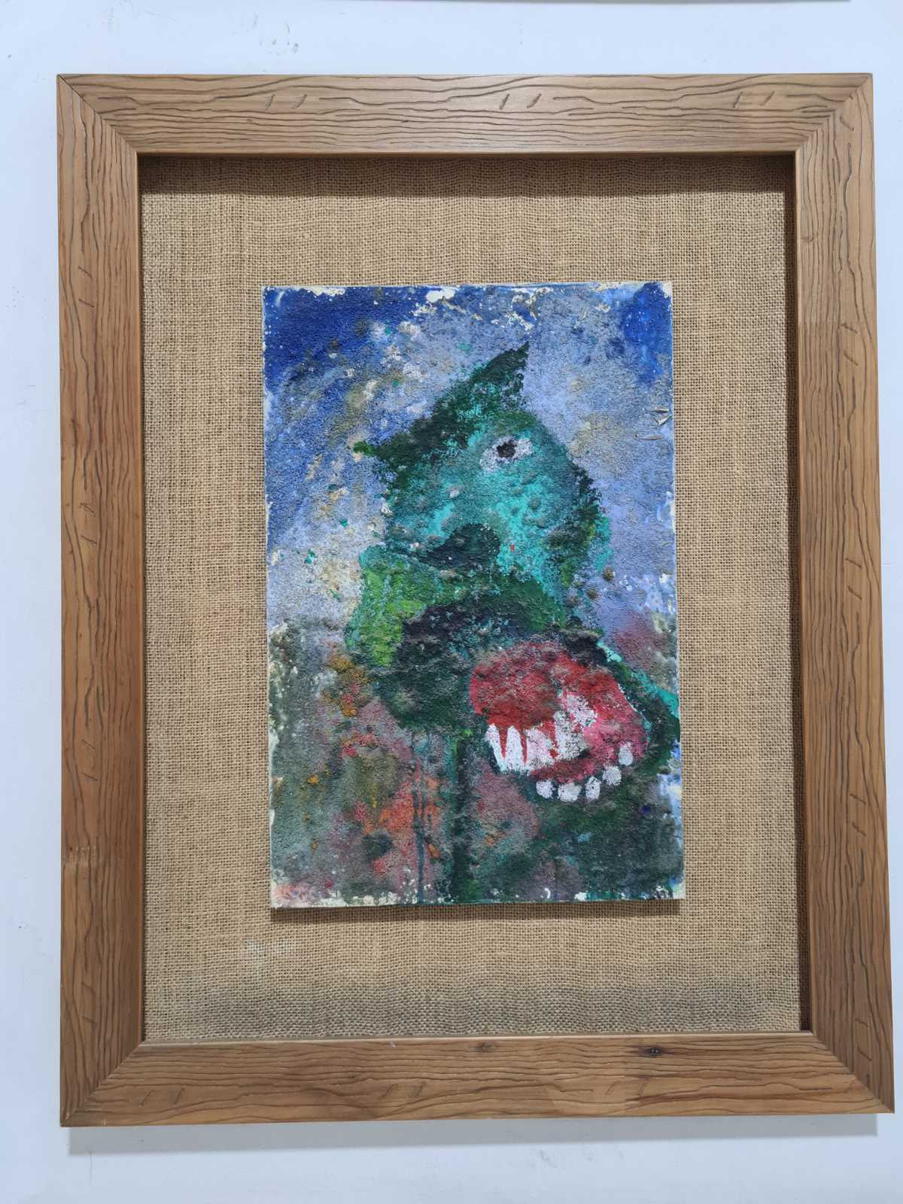
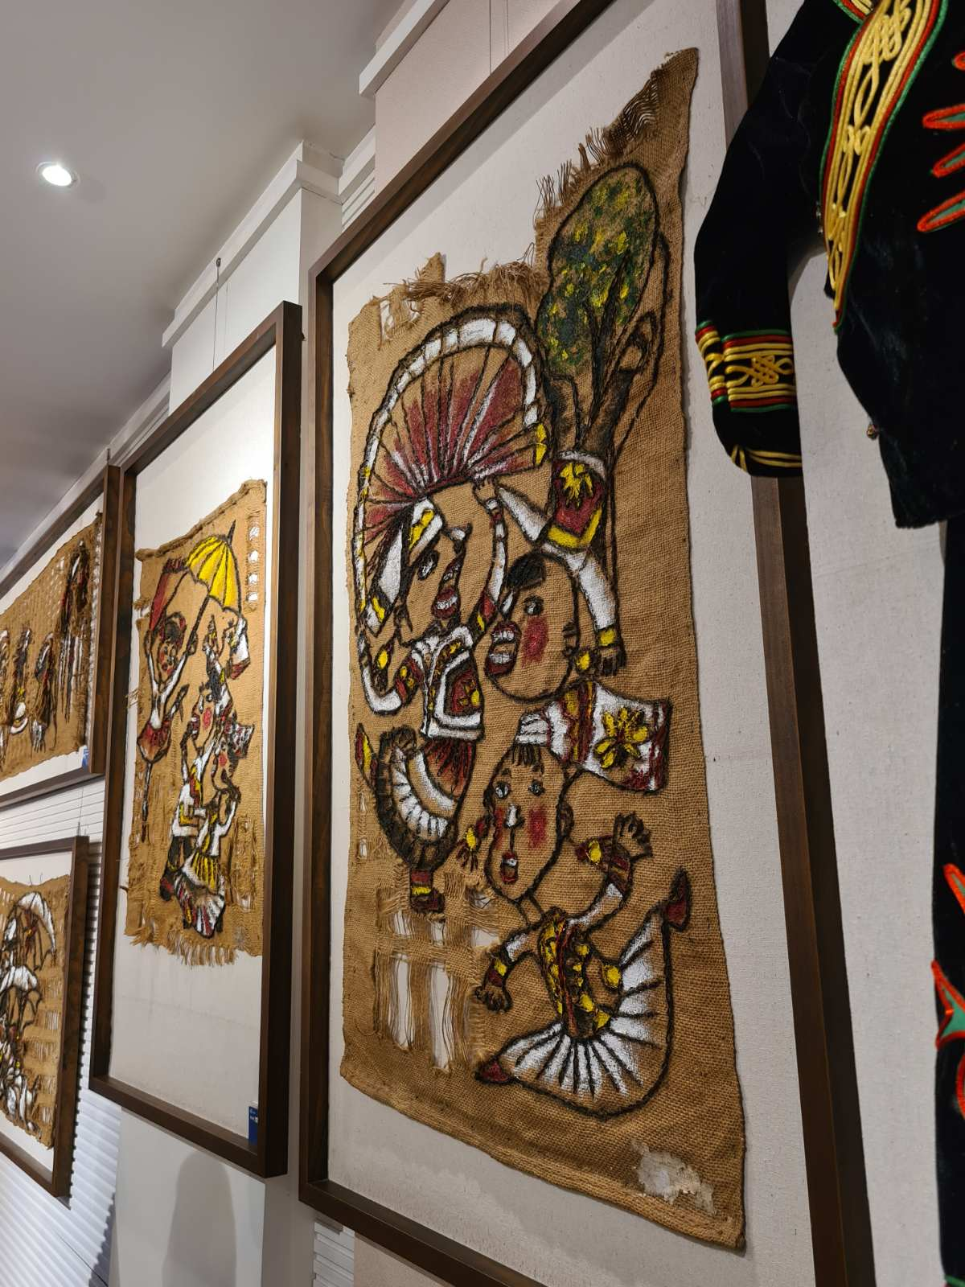
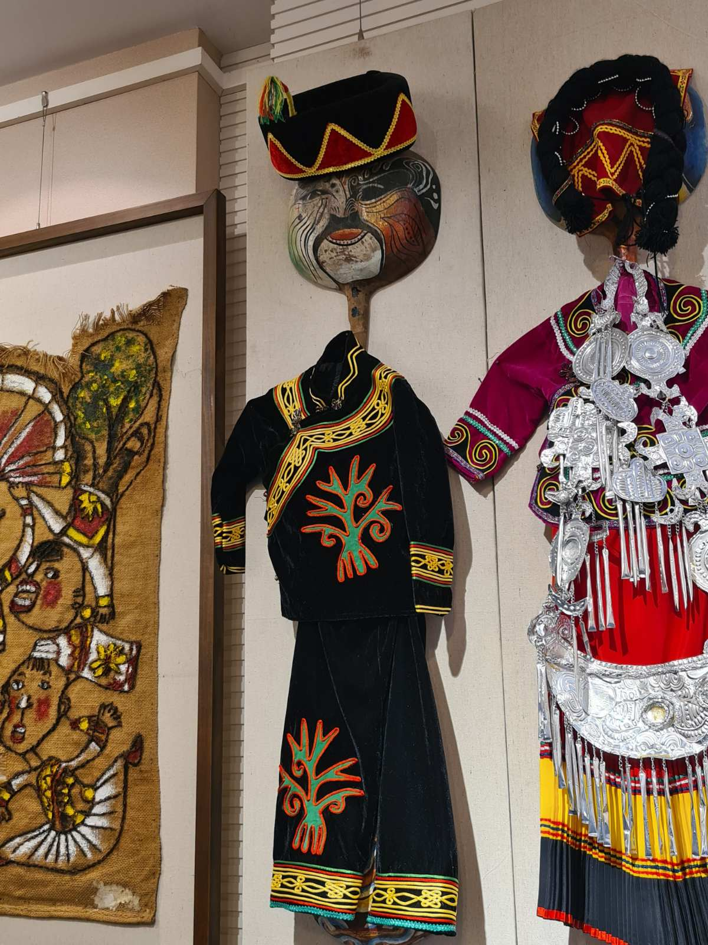
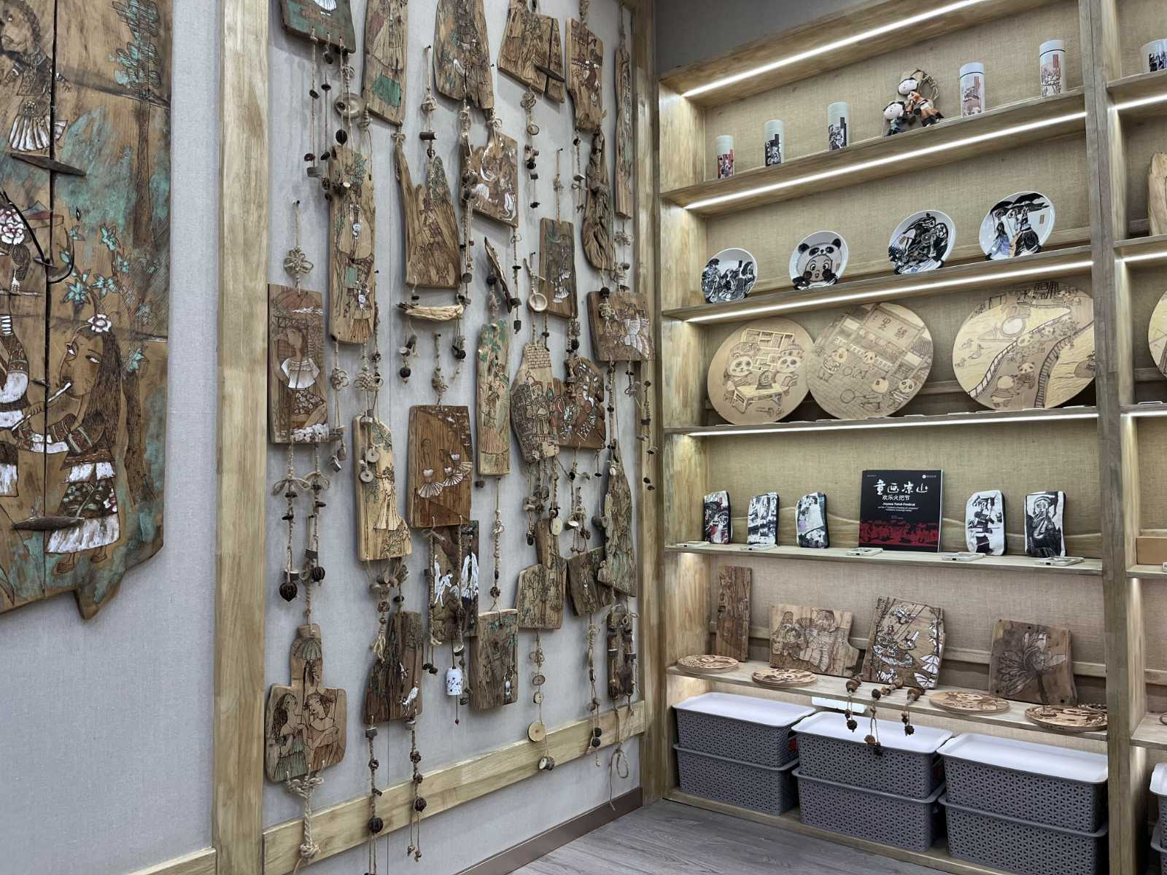
ARTWORK MADE BY THE STUDENTS

Slide 14
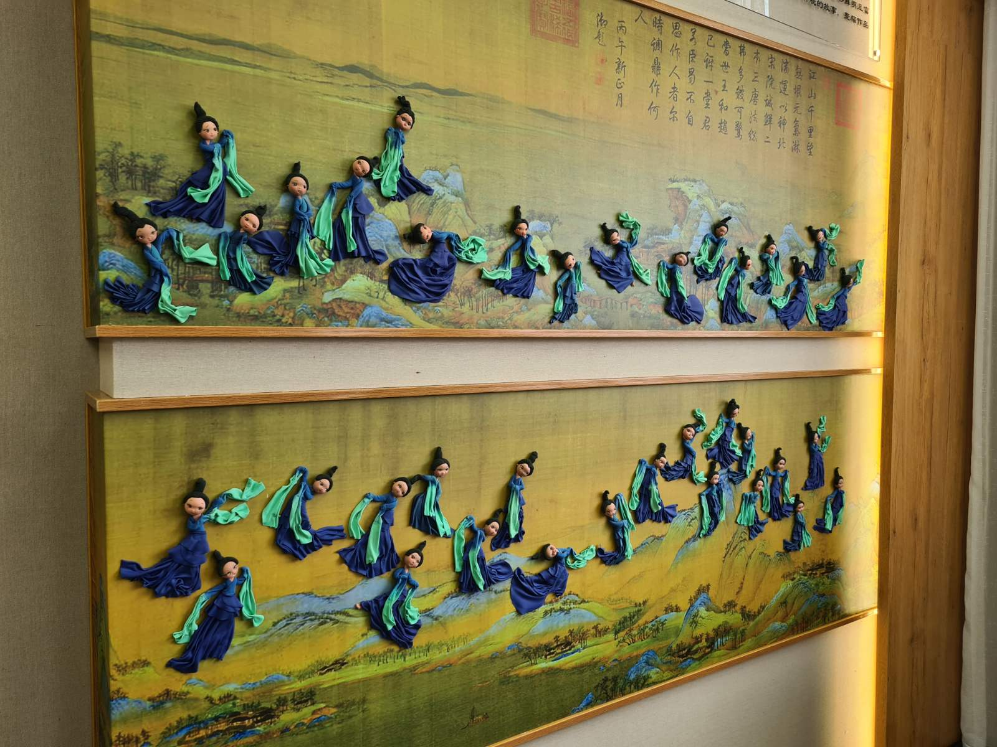
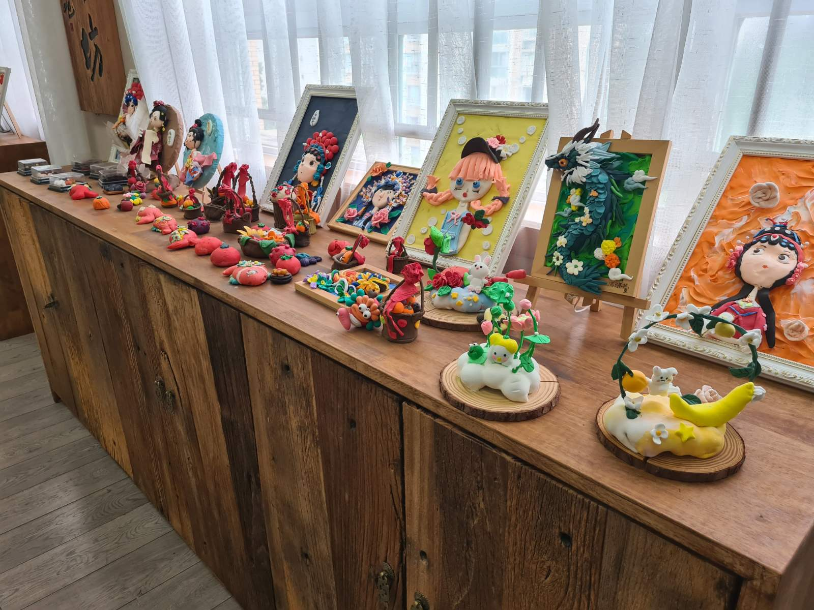
ARTWORK MADE BY THE STUDENTS

Slide 15
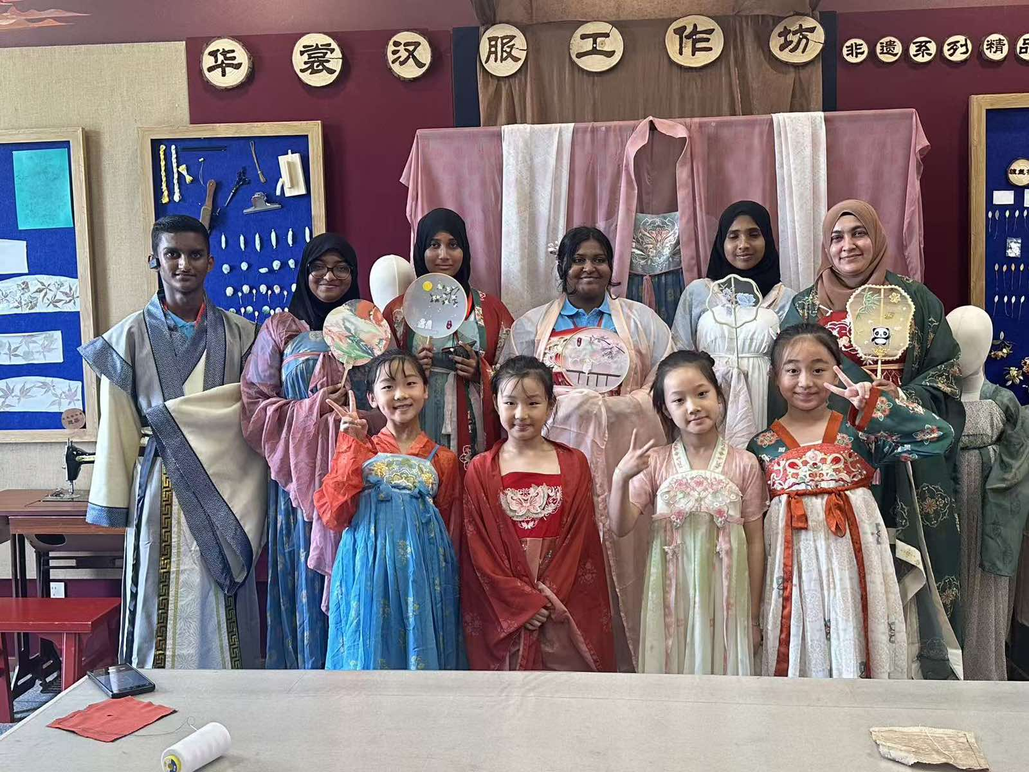
CHINESE TRADITIONAL DRESS MAKING

Slide 16

SICHUAN
OPERA

Slide 17
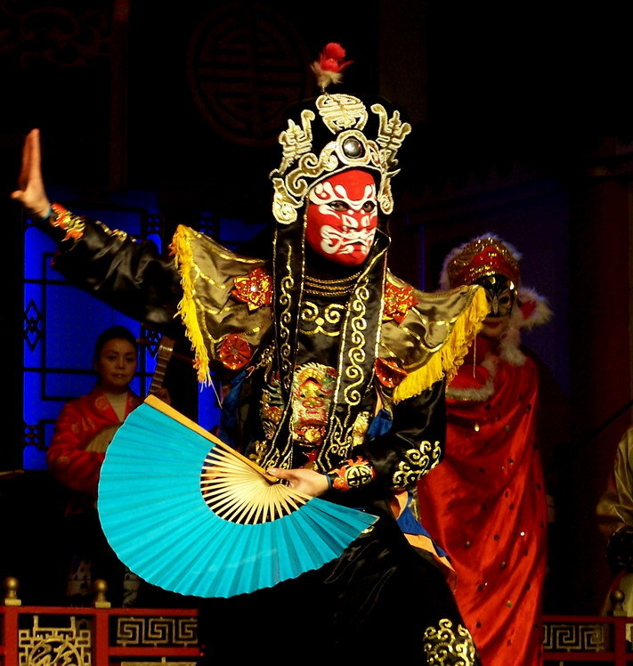
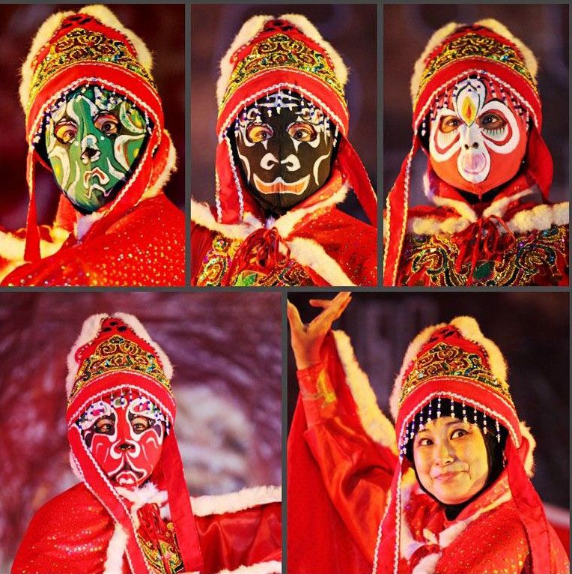
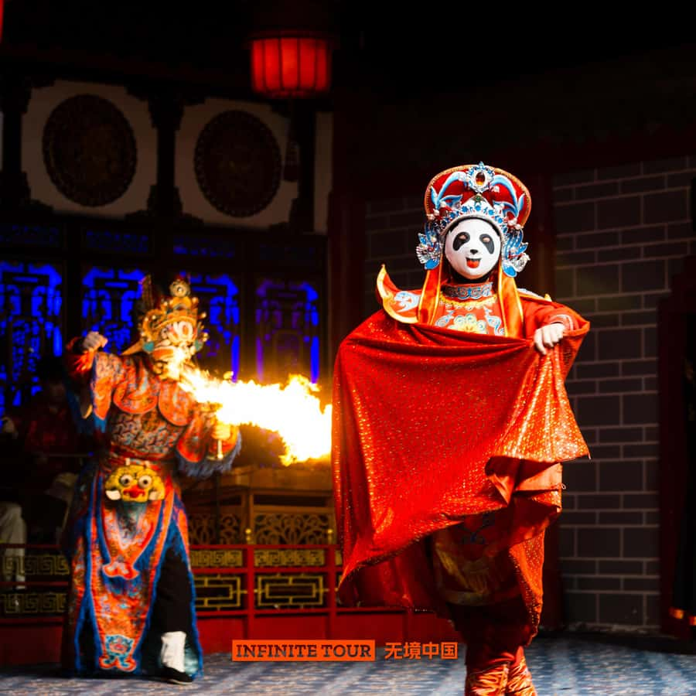
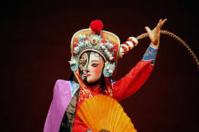
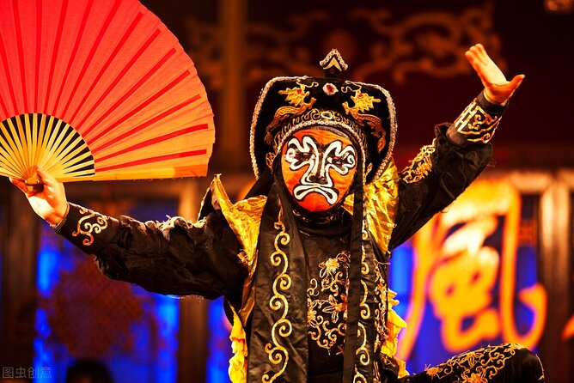
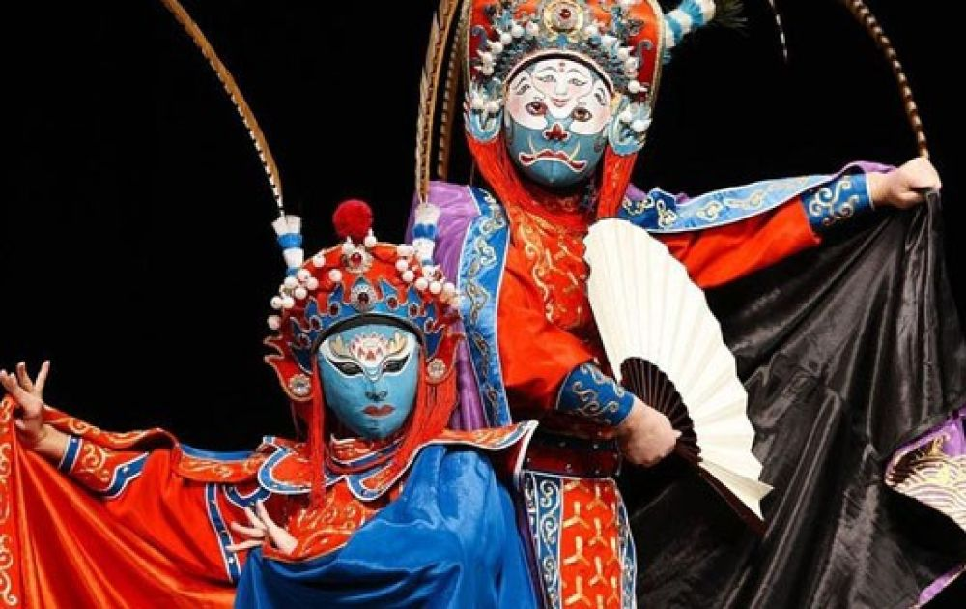
FACE CHANGING

